Slide 1
Fitness Management System
Build on Microsoft .NET Framework 4.0 technology
Progress report as of 15 Maret 2012

Slide 2
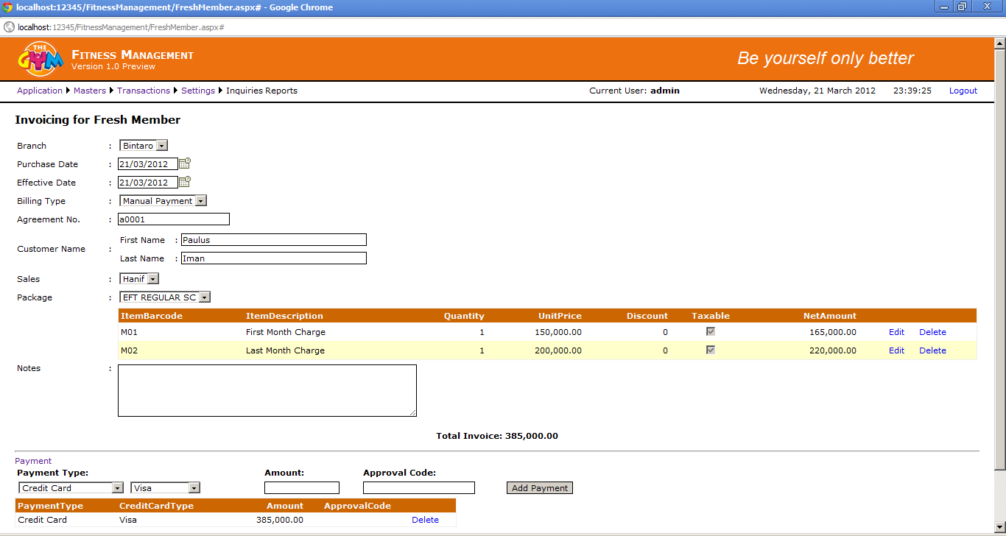
Fresh Member

Slide 3
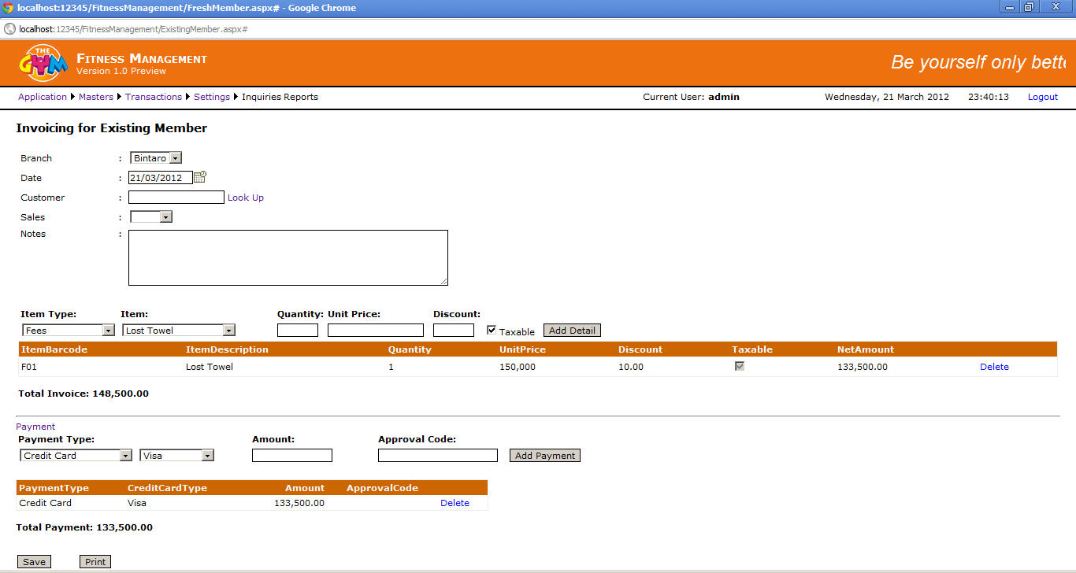
Existing Member

Slide 4
Progress Report
Current Week
Invoicing
Fresh Member
Existing Member
Contract (in progress)
Customer/Member (in progress)
Print invoice (waiting for official decision)
Re-Print invoice
Next Week
Void Invoice
Cancel membership
Freeze membership

